Slide 1

Software Solutions
MCTV
Joshua Cassidy - x15378586 Management and Collaboration
Joshua Cassidy - x16465134 Sales and Marketing
Laurence Foley - x15047911 IT Management
Ting Hao Chang - x16370076 Finance
Notes:
Presented by: Joshua Cassidy - x15378586

Slide 2
Agenda
Each Team Member’s Tasks
Gantt Chart
The Microsoft Database for MCTV
UML Diagram for MCTV
User guides for MCTV
The MCTV Website
The Future of MCTV
Questions
Notes:
Presented by: Joshua Cassidy - x15378586

Slide 3
Each Member’s Tasks
Joshua Cassidy (x15378586) the Team Manager managed and Documented the Trello, the Gantt Chart and GitHub. Created and designed the MCTV MicroSoft Database.
Joshua Cassidy (x16564134) created the UML Diagram, Logo, MCTV color scheme, and researched SalesForce.
Laurence Foley (x15047911) designed and built the MCTV website.
Ting Hao (x16370076) worked on the Excel Sheets and researched on Sage Line 50.
Notes:
Presented by: Joshua Cassidy - x15378586

Slide 4
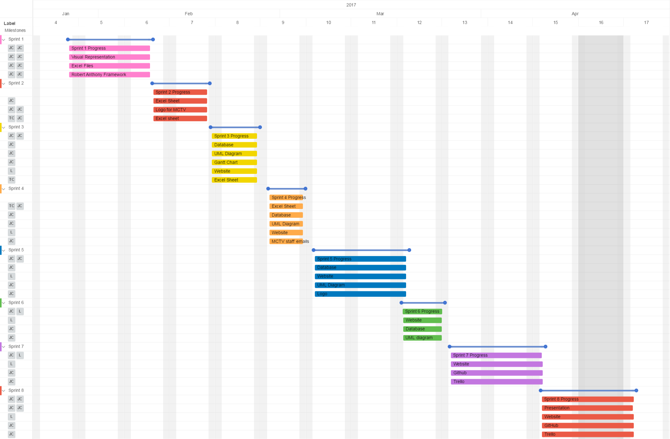
Gannt Chart
Picture of the MCTV Trello Gantt chart
Notes:
Presented by: Joshua Cassidy - x15378586

Slide 5
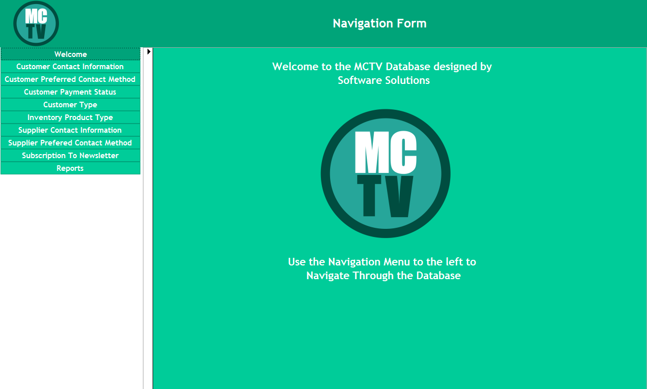
MCTV Database
Purpose of this Database
Features of the Database
Navigating the Database
Notes:
Presented by: Joshua Cassidy - x15378586

Slide 6
UML Diagram
What is a UML Diagram?
Purpose of this UML?
How the UML has evolved?
Notes:
Presented by: Joshua Cassidy - x16465134

Slide 7
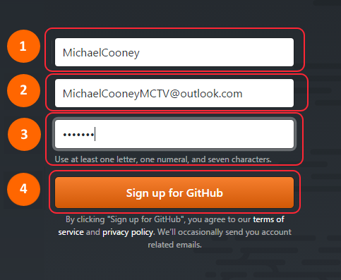
GitHub
What is GitHub?
Why use GitHub?
What does the GitHub User cover?
Notes:
Presented by: Joshua Cassidy - x15378586

Slide 8
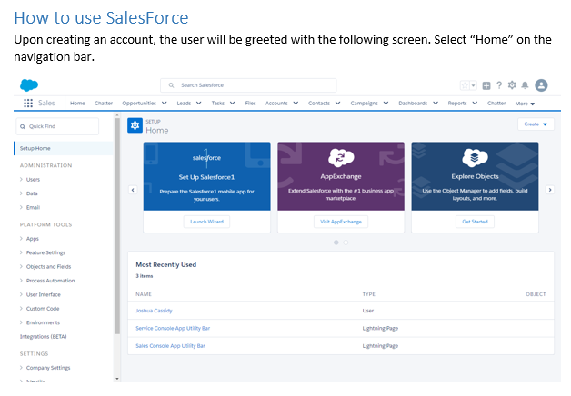
SalesForce
What is SalesForce?
Why use SalesForce?
What does the SalesForce User Guide cover?
Notes:
Presented by: Joshua Cassidy - x16465134

Slide 9
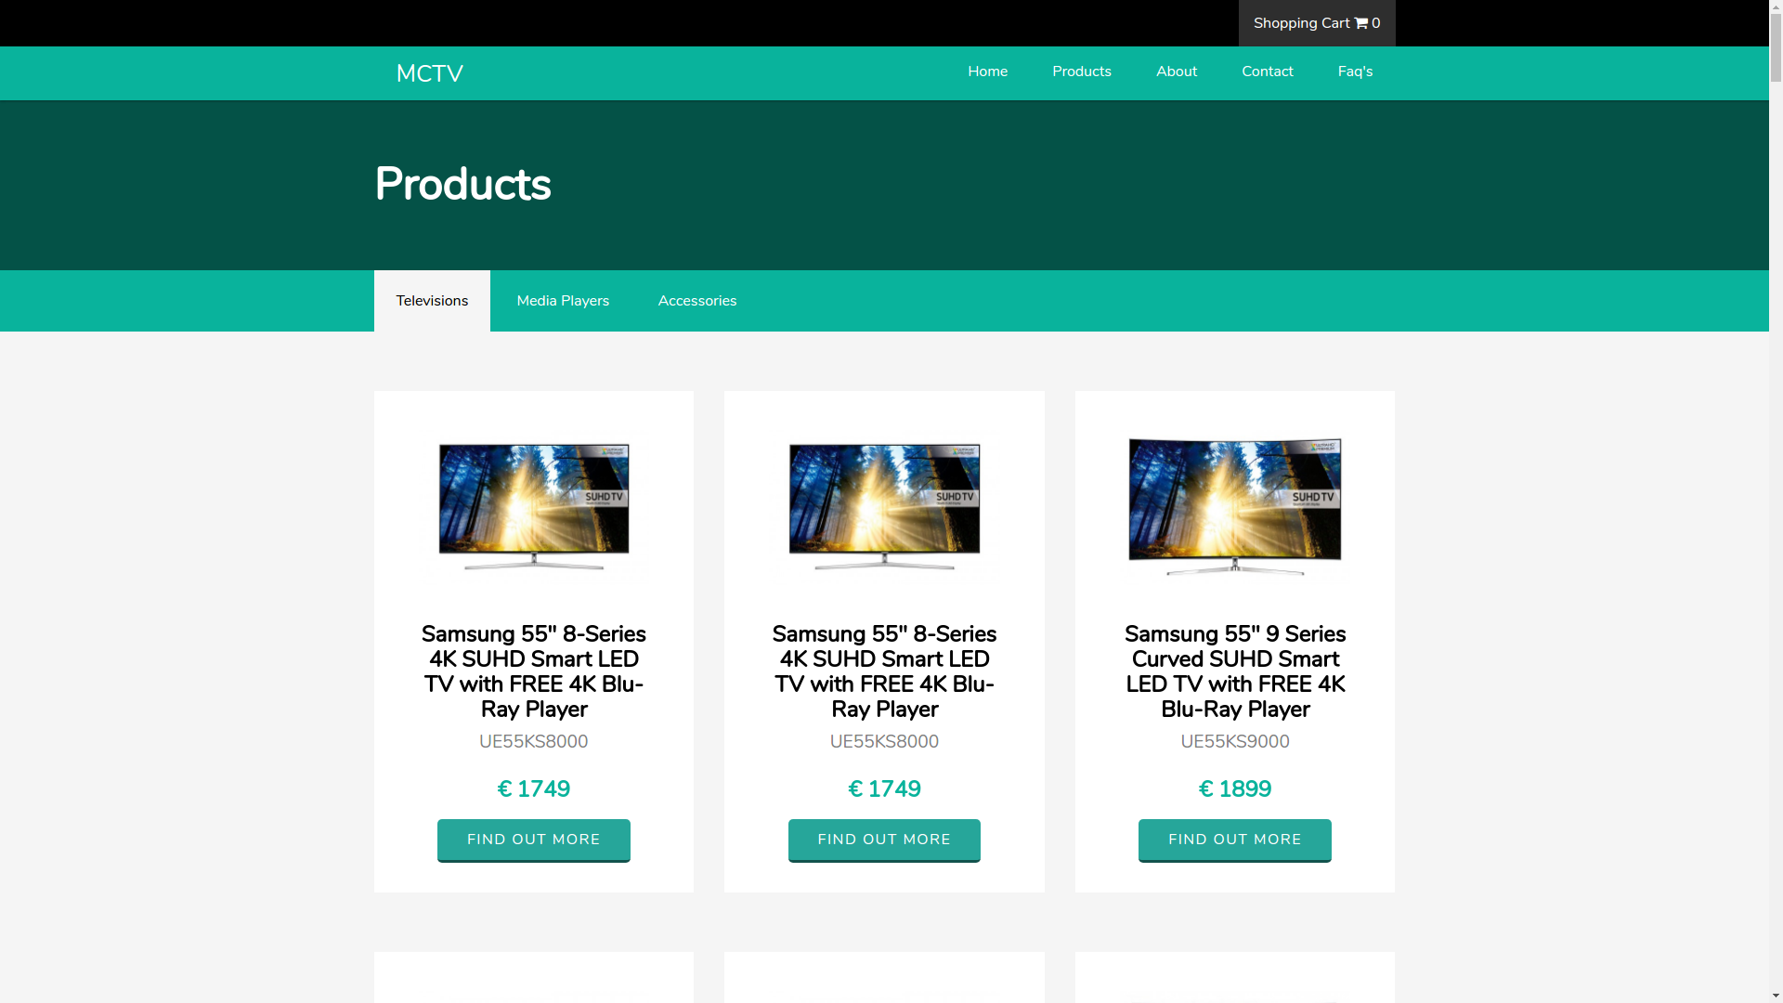
Website
Purpose of the MCTV Website
Tools used to create the Website
What does the website User Guide cover?
Notes:
Presented by: Laurence Foley - x15047911

Slide 10
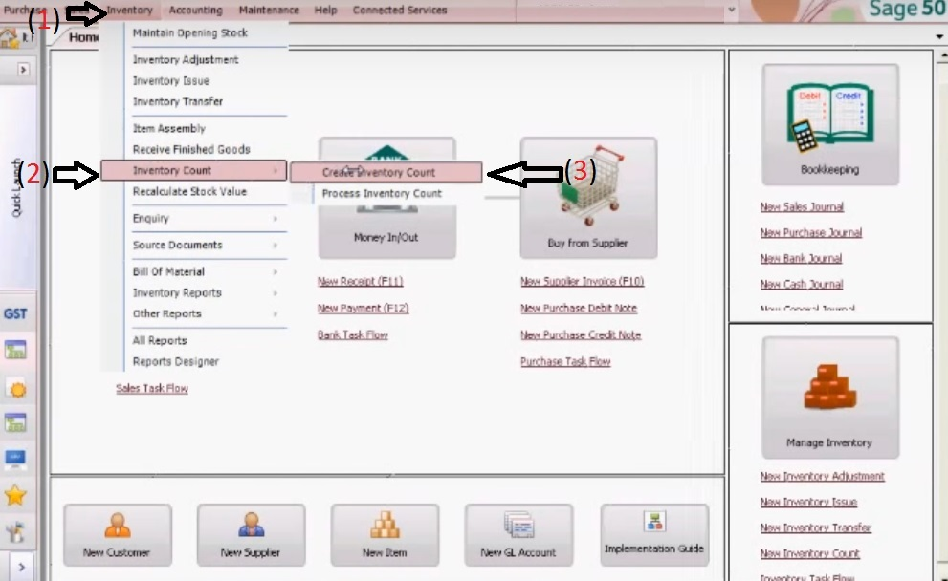
Sage
What is Sage Line 50 ?
Why use Sage?
What does the Sage User Guide cover?
Notes:
Presented by: Ting Hao Chang - x16370076

Slide 11
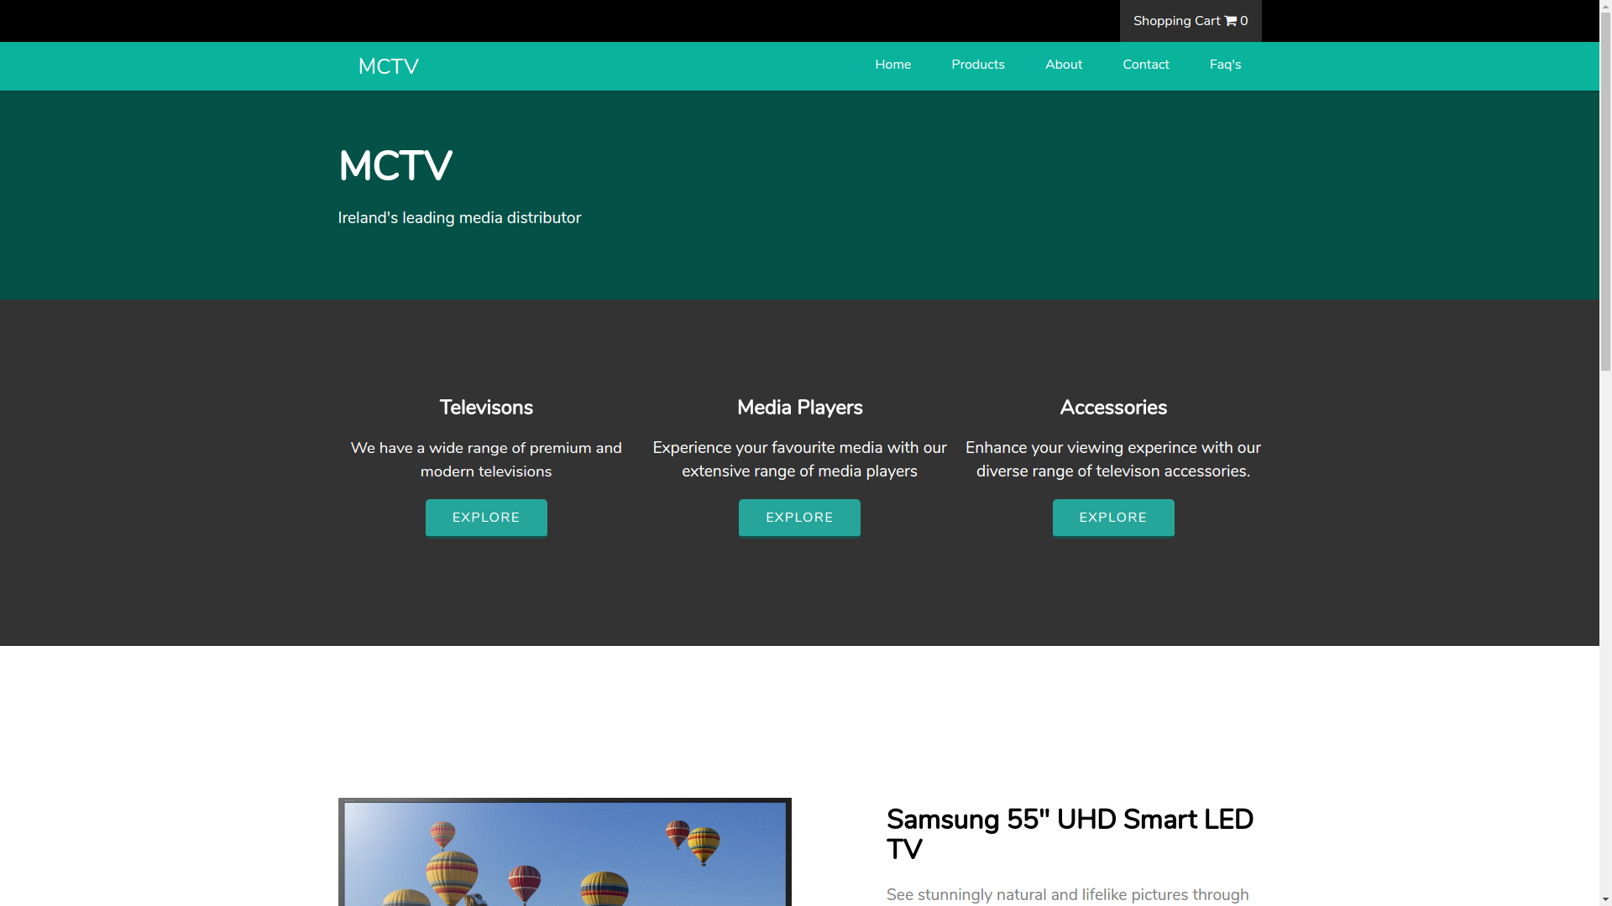
The MCTV Website Features
Notes:
Presented by: Laurence Foley - x15047911

Slide 12
Future Development
for MCTV
Our Solution
Notes:
Presented by: Joshua Cassidy - x15378586
The packages that MCTV will invest in Salesforce (2017), Microsoft Office Suite (Microsoft, 2017), GitHub (2017), Trello (2017) and for hosting Register365 (2017)

Slide 13
Future Development
Of MCTV
Month 1
Staff training to use new software
Purchase of the chosen packages
Creating a social media presence on FaceBook
Notes:
Presented by: Joshua Cassidy - x15378586

Slide 14
Future Development
Of MCTV
Month 2
Assign Stock Manager so the staff can remain updated on stock
Create the online market place and advertise market place
Integrate software packages
Notes:
Presented by: Joshua Cassidy - x15378586

Slide 15
Future Development
Of MCTV
Month 3
Implement new payment methods such as Google Pay
Allow for greater communication of company assets
Research market in order to better customer relationships
Notes:
Presented by: Joshua Cassidy - x15378586

Slide 16
References
Salesforce (2017) Sales Cloud Pricing [Online] Available at: https://www.salesforce.com/eu/editions-pricing/sales-cloud/ [Accessed 12 April 2017].
Microsoft (2017) Plans and & pricing [Online] Available at: https://products.office.com/en/business/compare-office-365-for-business-plans [Accessed 12 April 2017].
GitHub (2017) Plans for all workflows [Online] Available at: https://products.office.com/en/business/compare-office-365-for-business-plans [Accessed 12 April 2017].
Register365 (2017) Compare Packages [Online] Available at: https://www.register365.com/web-hosting/packages/compare [Accessed 12 April 2017].
Trello (2017) Compare Packages [Online] Available at: https://trello.com/business-class [Accessed 12 April 2017].

Slide 17
Questions?
Notes:
Presented by: Joshua Cassidy - x15378586

